Slide 1
Form-Filler: A Hybrid Approach to Managing Business Forms
Presented by 周桢瑜

Slide 2
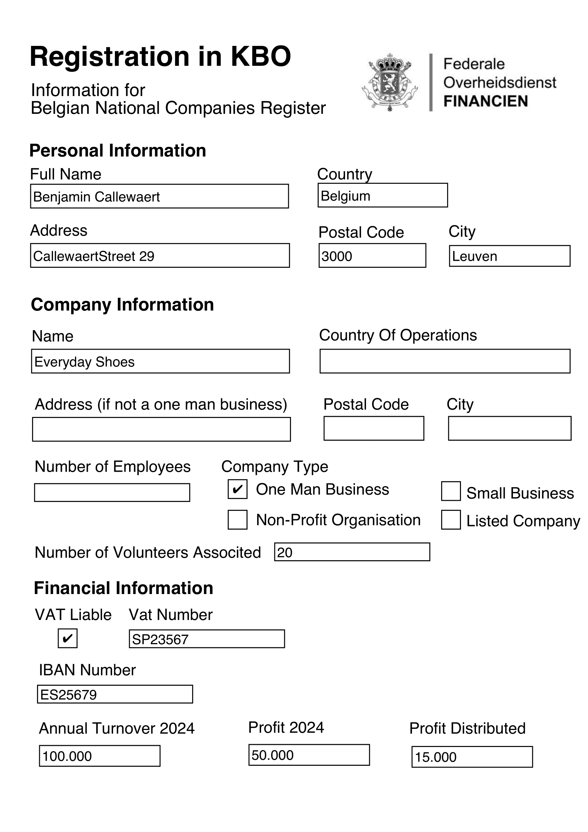
Form-Filler
Form-Filler, a hybrid framework integrating Multi-Modal Large Language Models (MLLMs) with automated reasoning to address these limitations. The MLLM extracts information from structurally and linguistically diverse forms, while the formalized compliance rules—ranging from rules as simple as validating postal codes against cities to complex VAT compliance—enable automated reasoning to ensure logically consistent information extraction. A modular Knowledge Base allows seamless rule updates, and the system guides users during data entry.

Slide 3
Form-Filler
Form Compliance Validation: First, the system needs to be able to verify whether a submitted form matches existing information and adheres to information compliance rules. This validation step identiﬁes discrepancies, such as contradictory regulatory claims, and explains why these discrepancies occur.
Consistent Information Extraction: The system should ensure logical consistency with compliance requirements, mitigating errors introduced by data-driven methods.
Dynamic Information Entry Guidance: If inconsistencies arise, the system should be able to provide explainable feedback to steer corrections. Thus ensuring that errors are mitigated at the point of entry, rather than post hoc.

Slide 4
Form-Filler
First, geographic validity requires that every city is combined with it’s valid postal code and belongs to the declared country.
Second, if a company is not exempt from VAT a VAT number should be speciﬁed.
Company classiﬁcation limits types to predeﬁned categories (One-Man Business, NonProﬁt Organisation, Small Business and Listed Company) with constraints: One-Man Businesses have no employees, and Non-Proﬁt Organisations cannot distribute proﬁts to share members. Note that, the form also speciﬁes the number of volunteers.
Finally, ﬁnancial consistency ensures that reported distributed proﬁts never exceed total proﬁts.

Slide 5
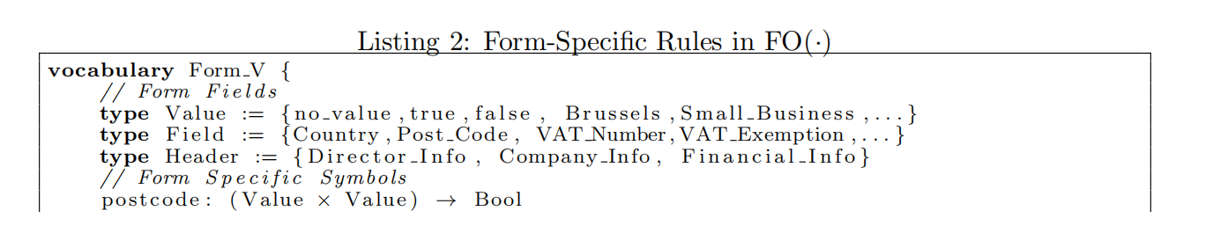
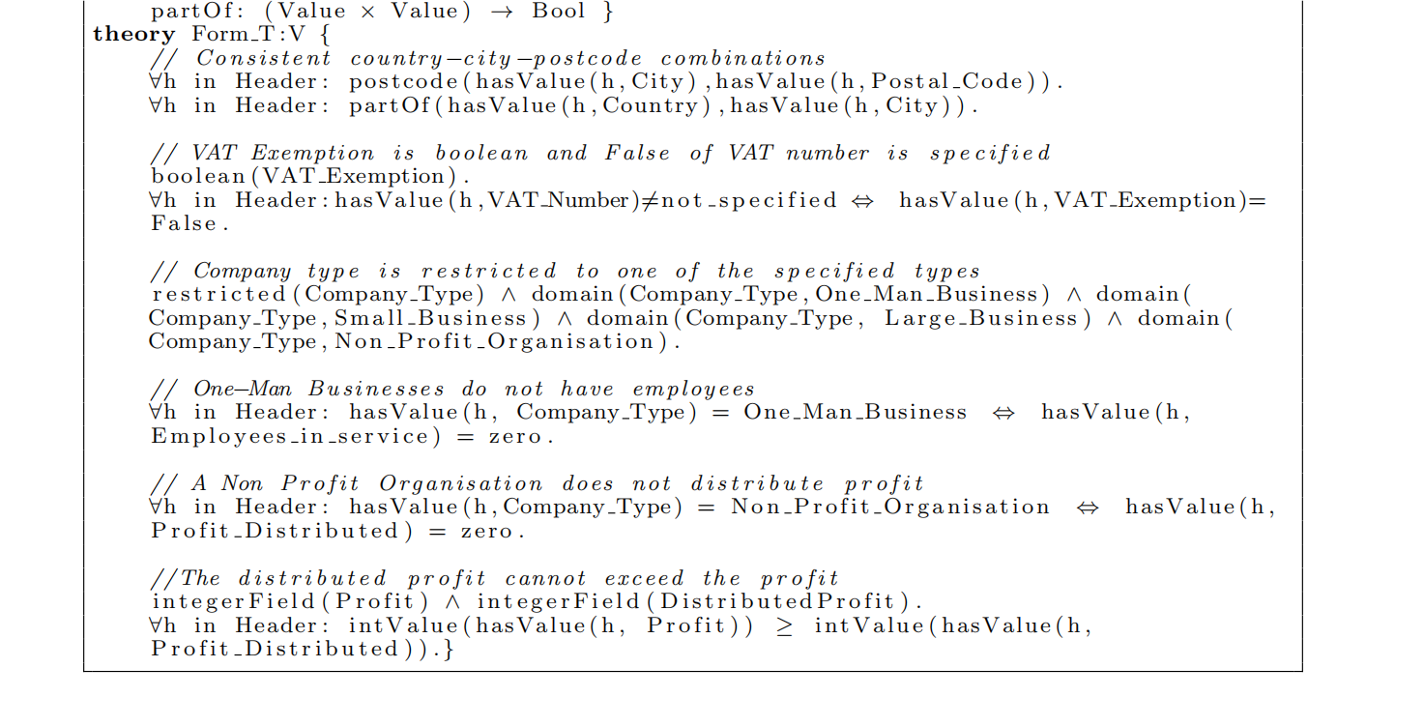
FO(·) and declarative knowledge base
First, geographic validity requires that every city is combined with it’s valid postal code and belongs to the declared country.
Second, if a company is not exempt from VAT a VAT number should be speciﬁed.
Company classiﬁcation limits types to predeﬁned categories (One-Man Business, NonProﬁt Organisation, Small Business and Listed Company) with constraints: One-Man Businesses have no employees, and Non-Proﬁt Organisations cannot distribute proﬁts to share members. Note that, the form also speciﬁes the number of volunteers.
Finally, ﬁnancial consistency ensures that reported distributed proﬁts never exceed total proﬁts.

Slide 6
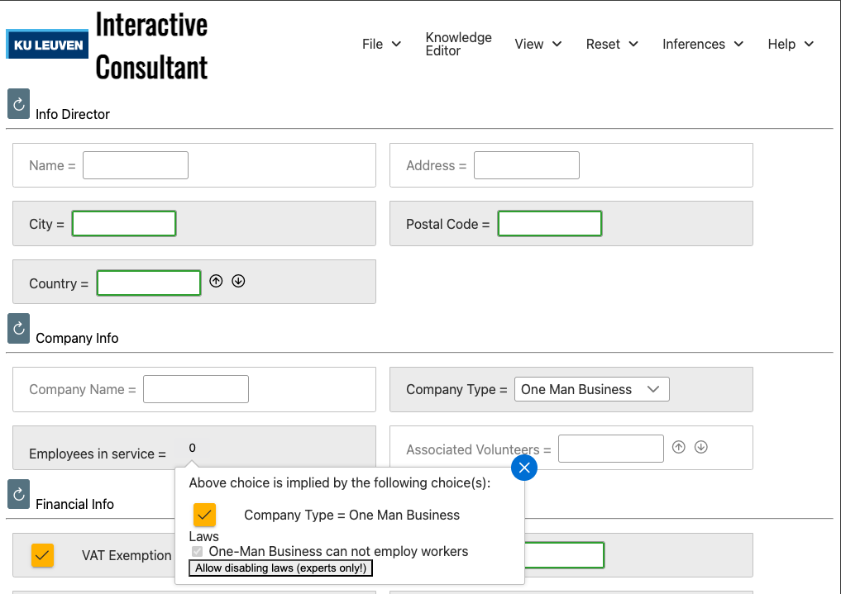
Form Compliance Validation
Dynamic Information Entry Guidance
Extracted values are aligned with known terms via multilingual embeddings to ensure consistency. They are added to a knowledge base and validated using IDP-Z3 satisfiability inference. If inconsistencies occur, explanation inference identifies minimal conflicting subsets to trace and resolve rule or data violations.
The same rule knowledge base can also be utilized to guide users during information entry,by leveraging IDP-Z3’s propagation inference task to dynamically derive all logical consequences of the inputs provided so far. Although not fully implemented, a prototype interface based on the IDP-Z3 Interactive Consultant demonstrates thisfunctionality.
ZIP Code
PLZ
Postal Code

Slide 7
Consistent Information Extraction
First, the MLLM is instructed to return at least two possible values per field instead of a single value.
Next, to attach a notion of certainty to each extracted value, we extract the token probabilities from the model’s output.
We defined three logit-based strategies to estimate the certainty of each extracted value:
• The probability of the first token in the returned value.
• The maximum token probability of a token in the returned value.
• The average token probability across all tokens in the returned value.

Slide 8
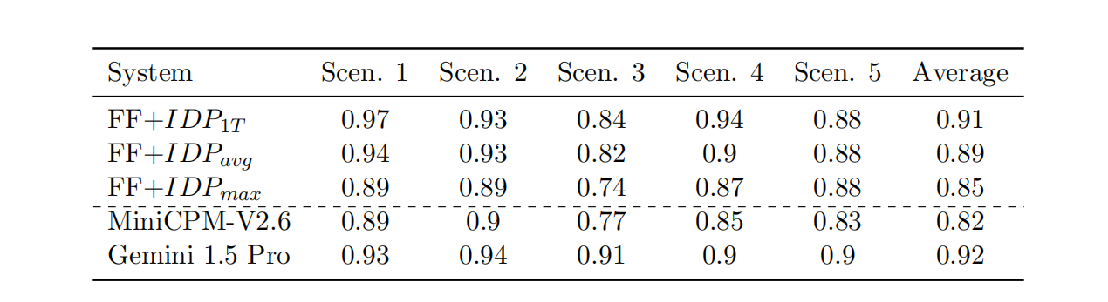
Experiment
• Scenario 1: A detailed company registration form from the Belgian National Registry, similar to the running example.
• Scenario 2: A Dutch-language variant of the registration form, with requested fields in Dutch, testing the multilingual capabilities of the system.
• Scenario 3: The Dutch form from Scenario 2, but with extraction fields specified in English, testing cross-lingual mapping capabilities.
• Scenario 4 & 5: A legal document outlining corporate governance structures and a personal loan application form, testing the approach robustness to different layouts and domains.

Slide 9
Discussion

